Slide 1
Excel layouts in Dynamics 365 Business Central
Introduced in the 2022 release wave 1

Slide 2
Excel layouts in four five bullets
Interactive reports (Not designed for print, One report can serve multiple purposes (filtering, sorting, slicers, pivot tables etc.)
Mix’n’match data from Business Central with other data sources (Sharepoint lists, On-premises databases, files, APIs, …) using Power Query in the report.
Use built-in, advanced Excel features to do post-processing on rendered reports (triggering automation flows, Organization data types, What-if analyses, Forecast sheet, Analyze Data with support for natural language)
Rich collaboration capabilities (commenting, sharing, protecting for certain audiences) on a report
Democratized design experience - allowing end users to participate more actively in layout creation. Contains the raw data, making it possible for a user to understand how the report works

Slide 3
Layout experience

Slide 4
Creating a layout in four easy steps
Get Excel workbook with the “data contract”
Edit existing Excel layout, or
Get blank template from request page, Schedule, Excel Document (Data only)
Layout data as you wish
Use almost any Excel feature (except VBA and password protection)
Import layout file into Business Central
On Report Layouts page, choose New Layout
Test layout
On Report Layouts page, choose Run Report

Slide 5
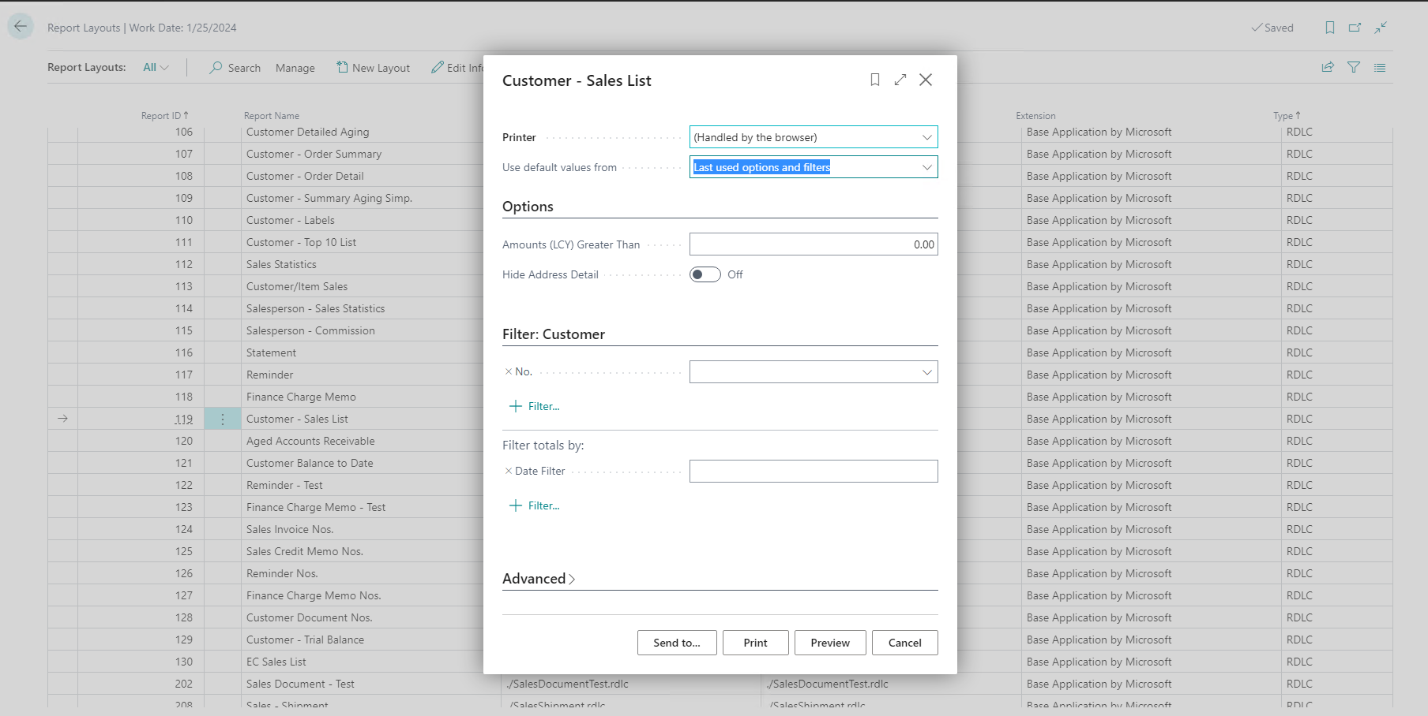
Get blank template

Slide 6
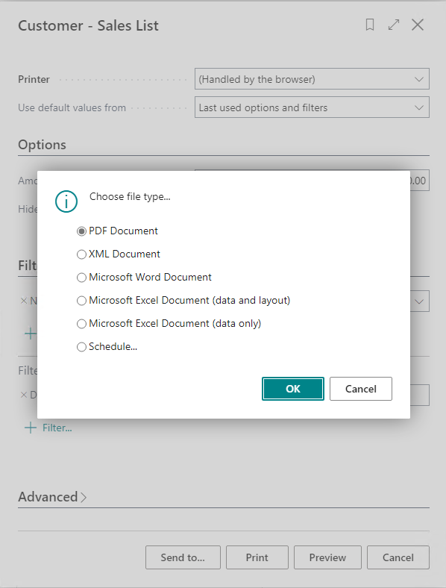
Get blank template

Slide 7
The “Data Contract” (do not change this)
Contract

Slide 8
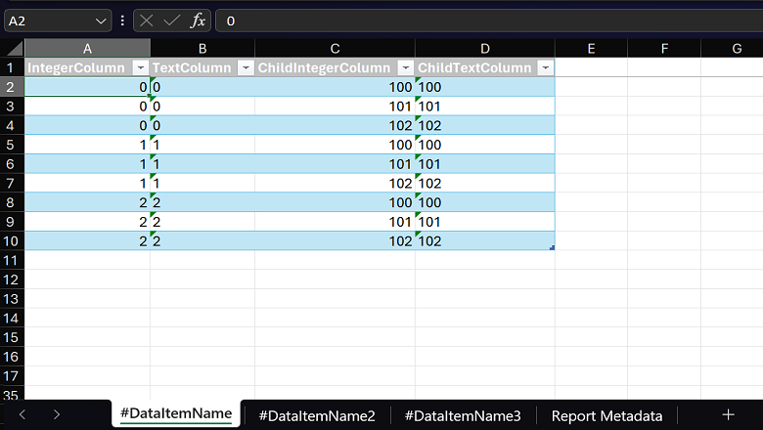
The “Data Contract” (do not change this) – new feature in 2023 release wave 2: multiple worksheets
Data contract

Slide 9
Translatable Excel layouts (23.3)
Idea: report author can use tags for
Worksheet names
Chart headers
Pivot elements
…
Server will replace tags at runtime when rendering the report.

Slide 10
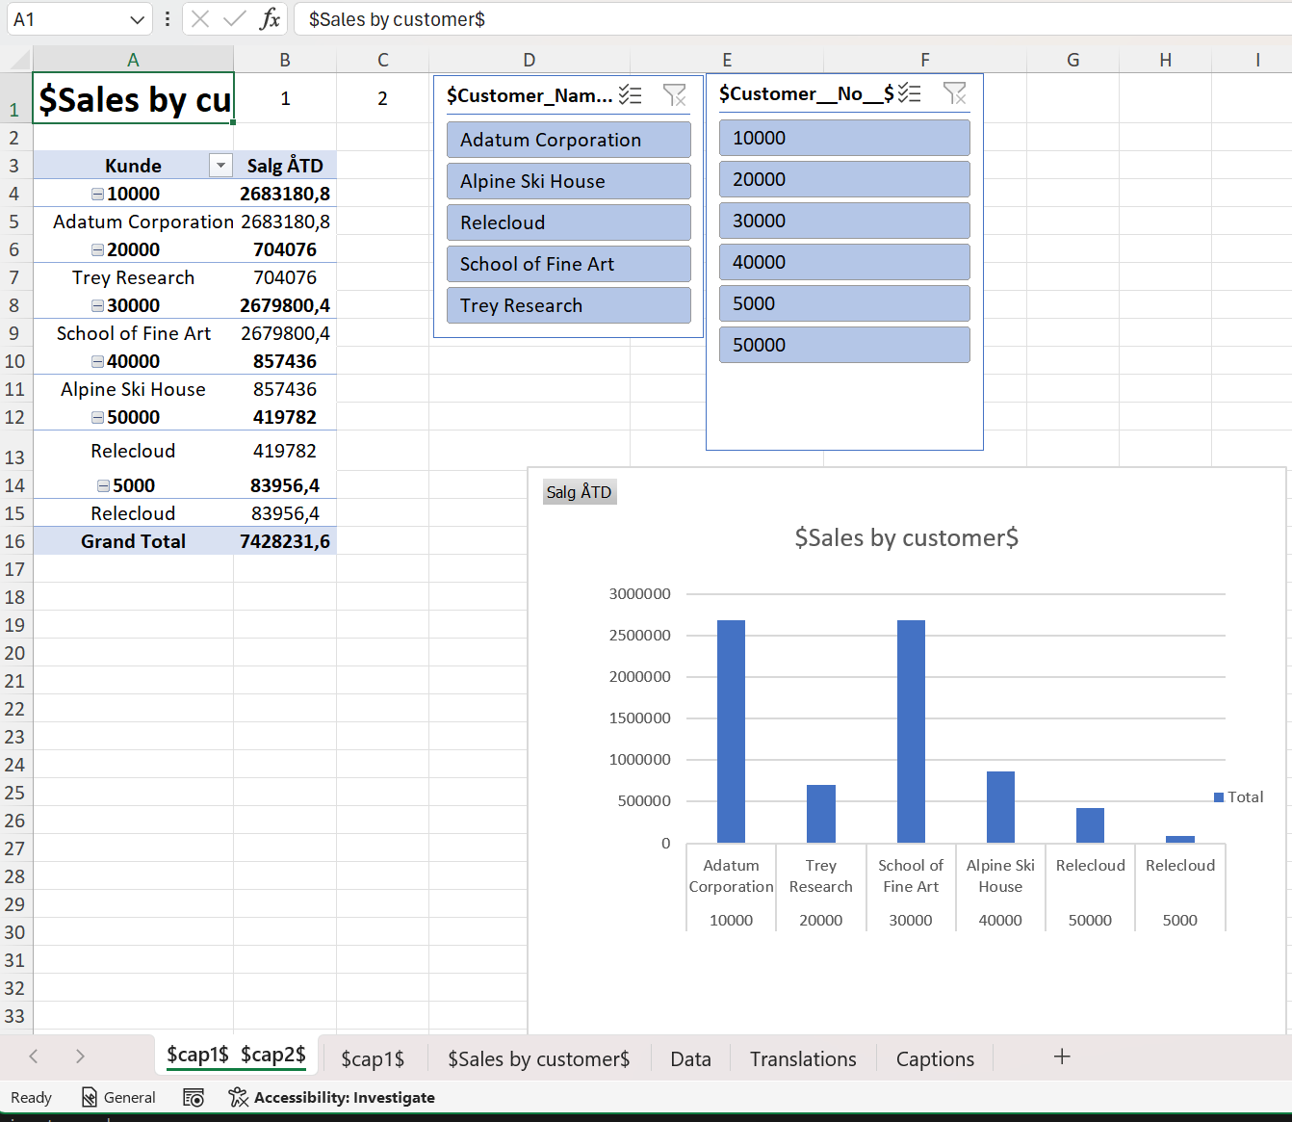
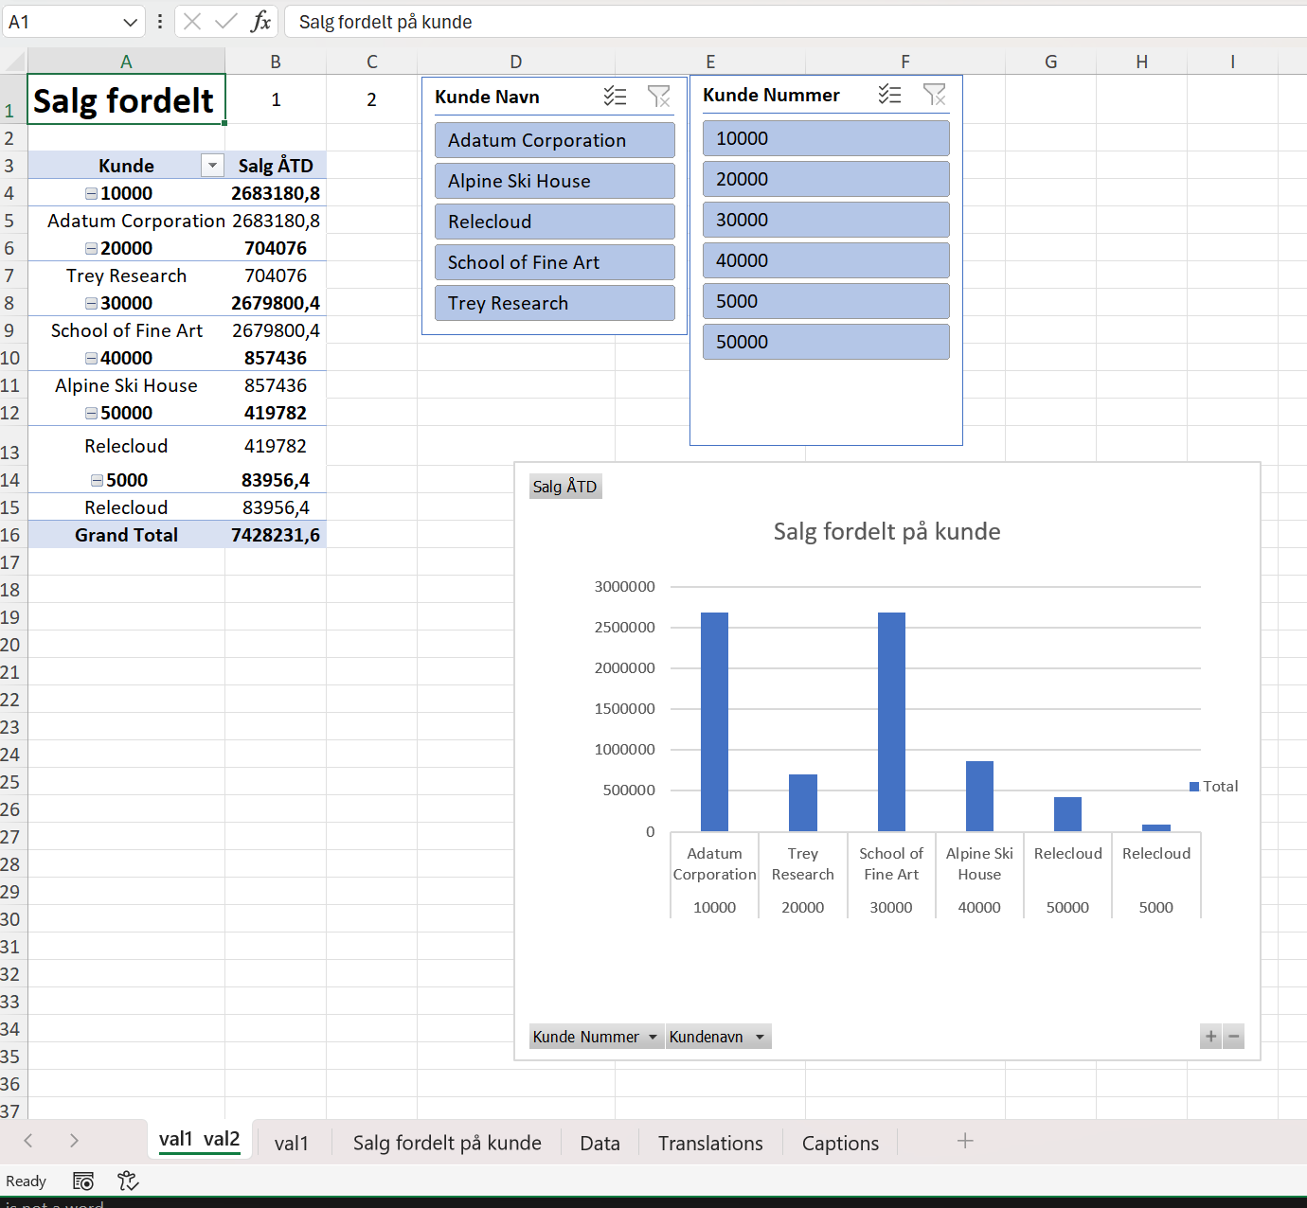
Translatable Excel layouts - example
Layout using $$ syntax
Report when user runs it

Slide 11
Static and runtime metadata worksheet (23.3)
Always have a (hidden) worksheet with
Report AL metadata
Request metadata
Request page filters
Report captions

Slide 12
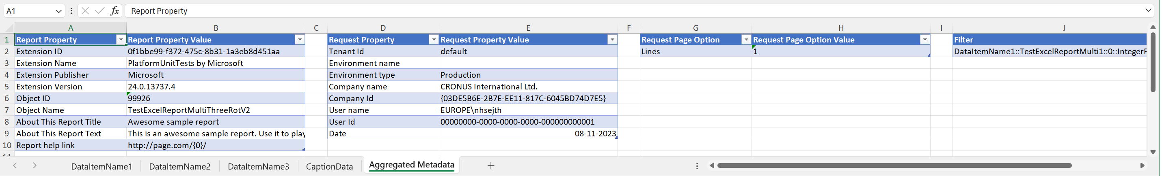
Report Metadata worksheet
Runtime metadata
Enables API based (refreshable) Excel reports
Company/User/Report date easily available for author
Static metadata
Enables ”About this report” info for author

Slide 13
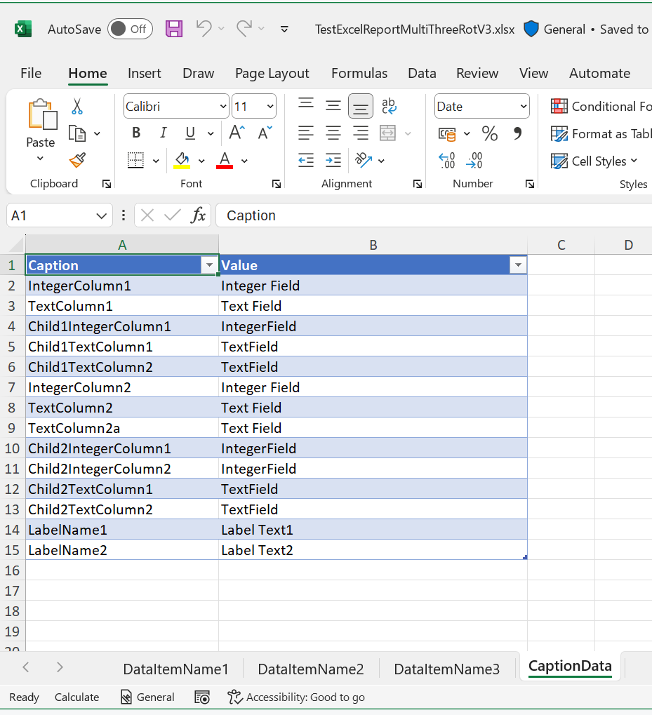
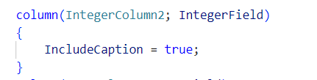
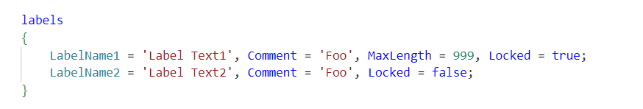
Caption data worksheet

Slide 14
Layout the data (pivot tables, slicers, and charts)

Slide 15
Use multiple pivot tables in the same report

Slide 16
Use table formulas to create calculated columns

Slide 17
Use PowerQuery to merge with external data

Slide 18
Credit scores loaded from Excel workbook on Sharepoint site

Slide 19
Importing the layout

Slide 20
Importing the layout

Slide 21
Importing the layout

Slide 22
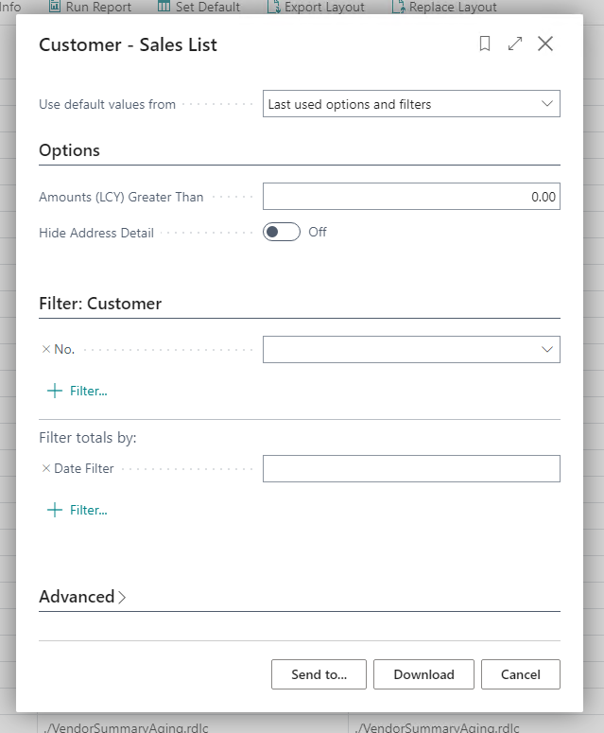
Testing the layout

Slide 23
Design guidelines (for layouts)

Slide 24
Worksheet naming and location
Locate worksheets in the order you think will be most useful for users so that they do not have to scroll when using the report.
Good worksheet names help users quickly get an overview of the information they can obtain by navigating to the worksheet.
An Excel worksheet can be up to 31 characters long.

Slide 25
One or multiple worksheets?
In contrast to a report designed for print or pdf, an Excel report typically consists of multiple worksheets, each of which is designed for a different purpose. Some common types of worksheets are
Overview dashboard
Pivot table
Table
Print-friendly
About the report
There is no technical limit to the number of worksheets in a report, but users probably prefer a number they can overskue.
Note that you can develop multiple Excel layouts for the same report, so maybe design for a specific persona.

Slide 26
One or multiple worksheets?
In contrast to a report designed for print or pdf, an Excel report typically consists of multiple worksheets, each of which is designed for a different purpose. Some common types of worksheets are
Overview dashboard
Pivot table
Table
Print-friendly
About the report
There is no technical limit to the number of worksheets in a report, but users probably prefer a number they can overskue.
Note that you can develop multiple Excel layouts for the same report, so maybe design for a specific persona.

Slide 27
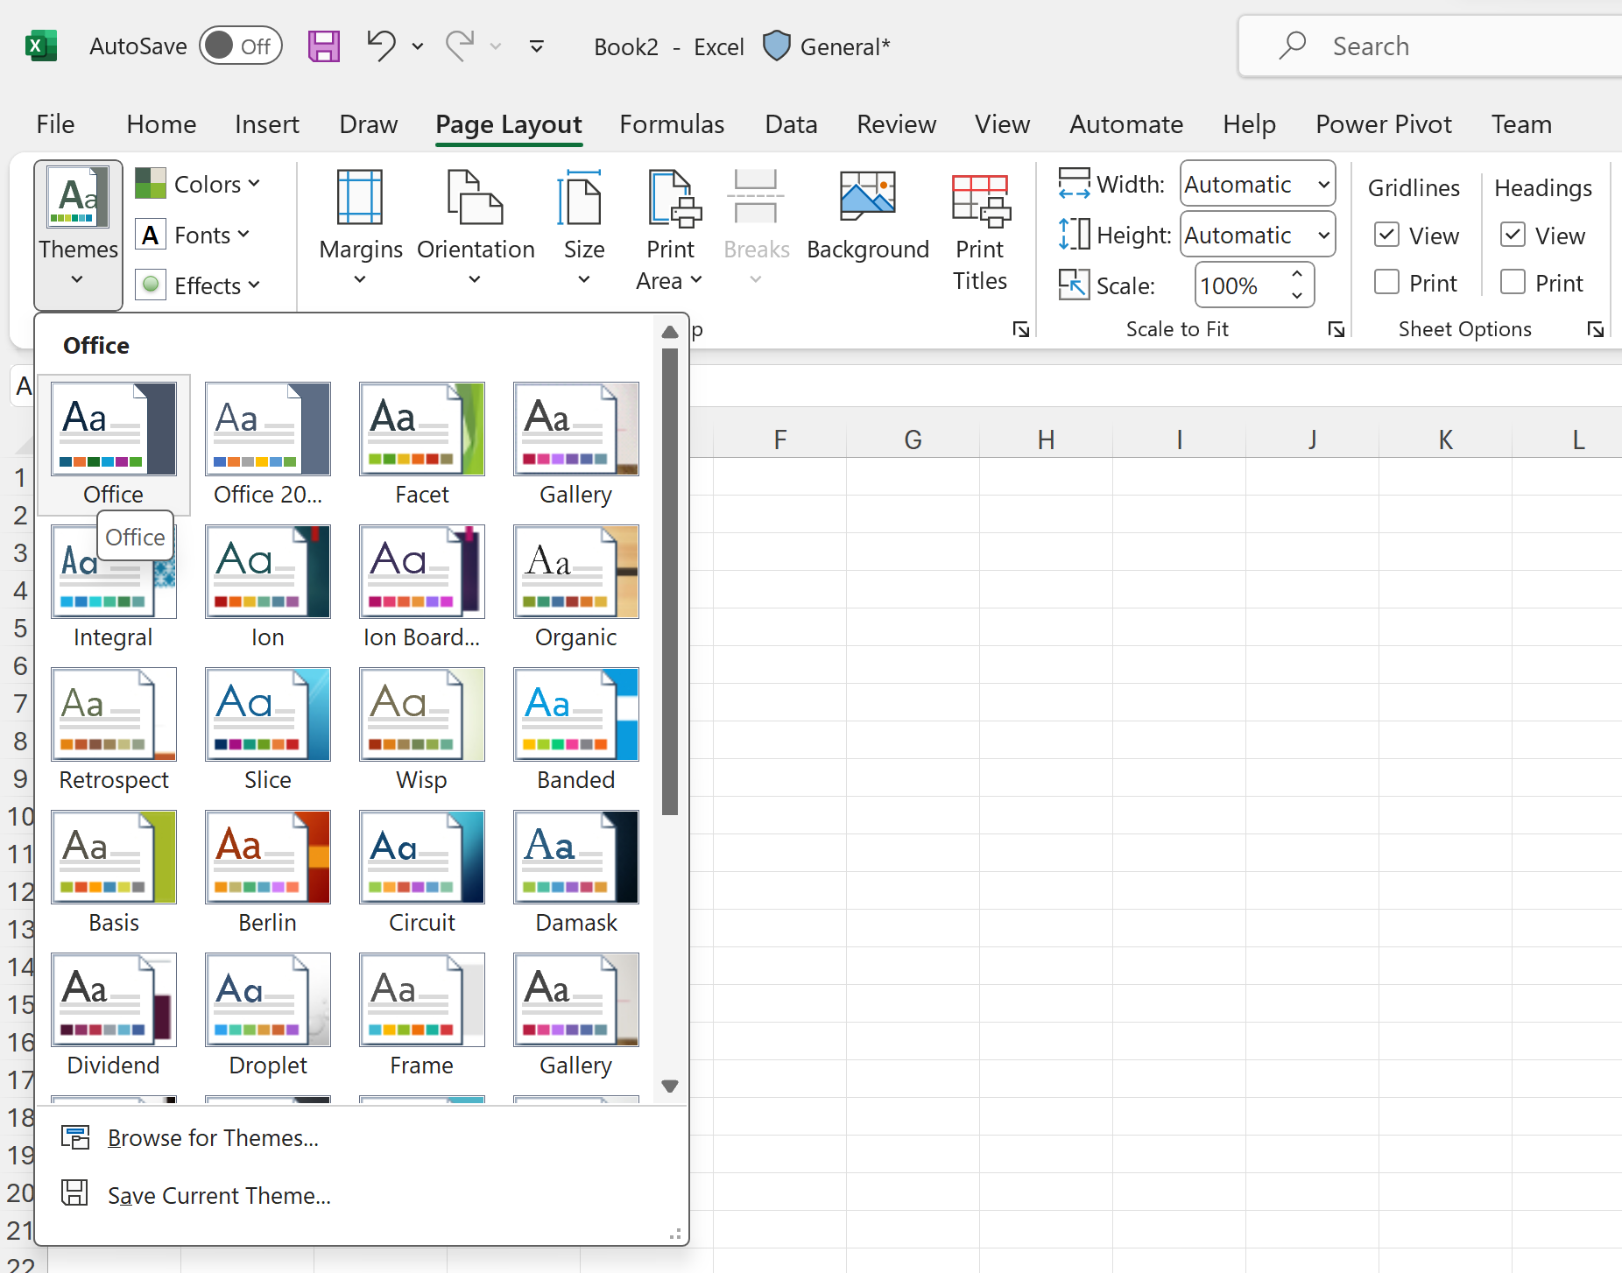
Using Office themes
Consider using a common Office theme for all your layouts.

Slide 28
Developer experience

Slide 29
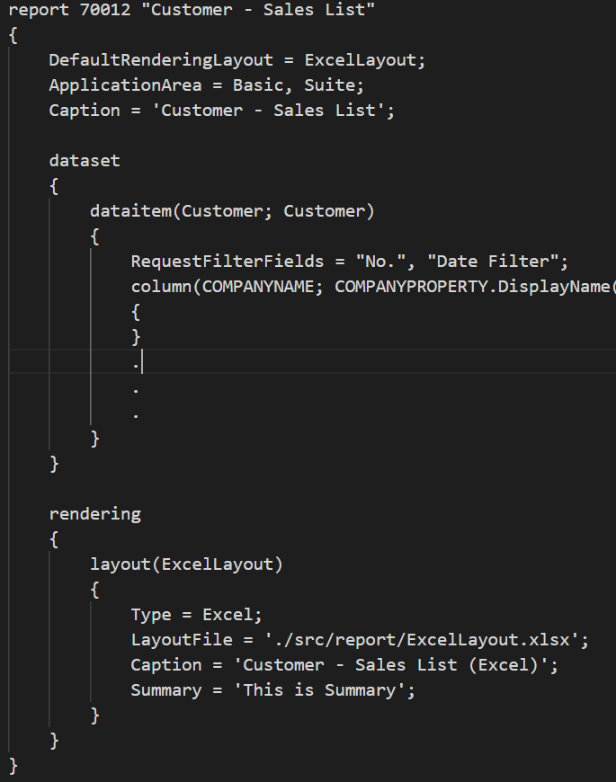
Developer experience
Create a Report Object in AL.
Define your report dataset.
Provide a path to your Excel Layout.
Publish your report extension.

Slide 30
What if I change the dataset definition?
Easiest way to change your layouts in the AL projects is simply to add the new fields (metadata) to the data contract worksheet

Slide 31
OneDrive Integration

Slide 32
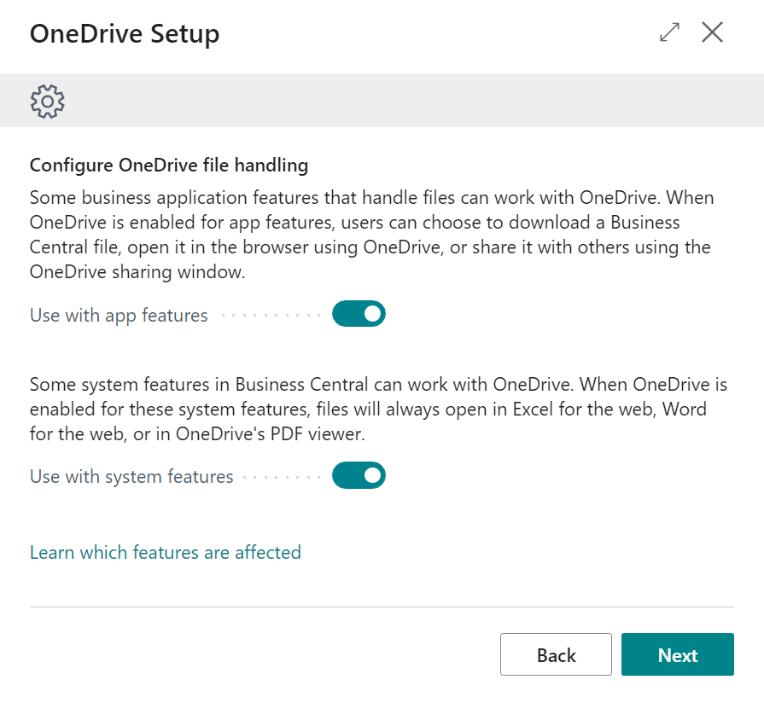
Configure OneDrive Integration
Unlocked actions
Open in OneDrive
Share window
Example features
Report inbox
Attachments factbox
Incoming documents
Sales Budgets
Customizations and add-ons
Notes:
These file sharing experiences are consistent across the business application, giving you the choice to Open, Share or download, and handling file collisions this same way.
Next, lets look at examples of System features

Slide 33
Affected features
Open in Excel
Edit in Excel
Report export (layouts ☺)
Notes:
There are a few system-wide features that take advantage of OneDrive
Exporting lists to Excel
And also exporting Reports to Excel, Word
Sam why don’t you show us how Edit in Excel works with OneDrive?

Slide 34
Power BI integration

Slide 35
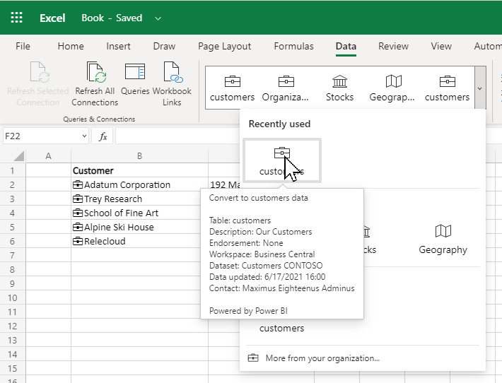
Ad hoc reporting - Excel Organization Data Types based on Business Central
Built in Excel data types expand with ones defined by you for your organization
Based on shared Power BI dataset and “featured” tables (needs PRO license)
Ideal for reference data: items, customers etc
Works for on-premises and cloud
Auto data refresh - as requested in Power BI

Slide 36
Where does Excel layouts shine?

Slide 37
Use Excel layouts when
The report dataset fits Excel
Less aggregated is good
Less formatted data is good
The users want to interact with the data
A paper copy is not a priority

Slide 38
Understanding the numbers and process
A report with an Excel layout contain the raw data
aka data lineage (what data lies below this report)
Possible for a user to understand how the report works
aka process lineage (which steps were taken to transform the raw data to the results in the report)

Slide 39
Democratizing the layout experience
Report development in Business Central consists of two parts
developing the report dataset (the report object)
developing the layout (Word/RDLC/Excel)
With Excel layouts, report layout experience is now in the hand of normal users
Given that the dataset has the data needed in the correct format, end users now have total freedom to change the look and feel of the report, add additional views on the data, filter and sort as they need, etc. If one of these modifications make sense to save, they can just import it as a new layout.

Slide 40
Excel layout samples

Slide 41
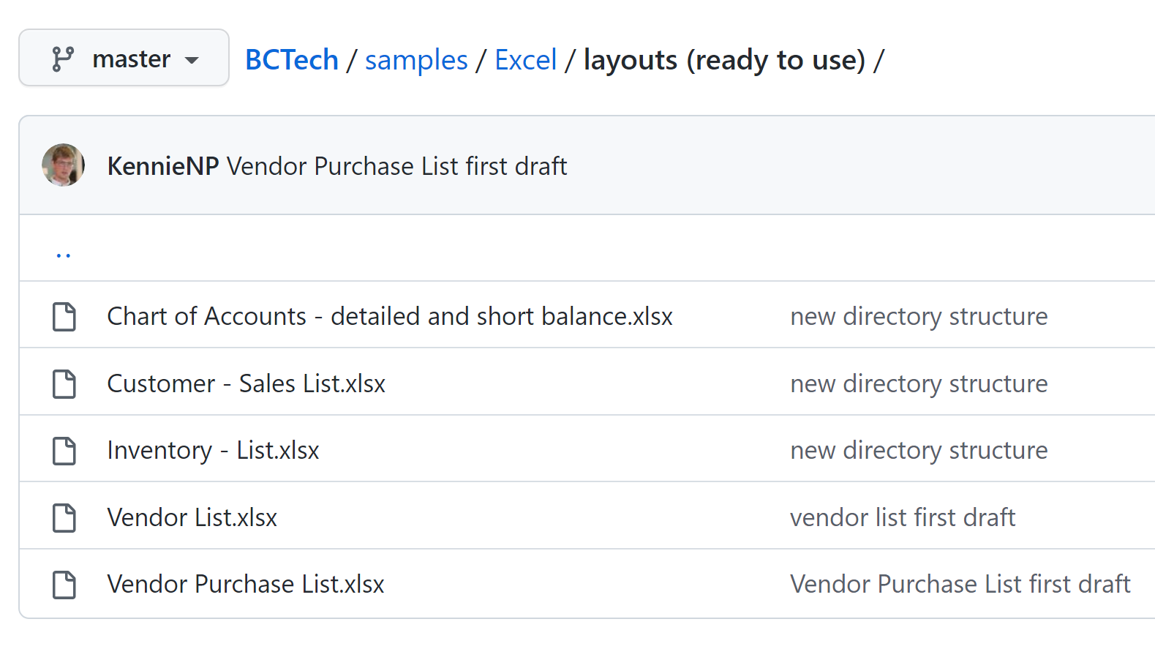
aka.ms/bcexcelsamples

Slide 42
Post-processing (with Excel)

Slide 43
Using Excel features to do post processing and data analysis
Sort & Filter
Data Tools
Forecast
Outline data
Power Pivot
Data Insights
…

Slide 44
Post-processing in Excel – Sort & Filter
Slice’n’dice data on worksheets

Slide 45
Post-processing in Excel – Data Tools
Manipulate data for further analysis

Slide 46
Post-processing in Excel – Forecast
If data is laid out right, maybe you can use Excel forecasting features

Slide 47
Post-processing in Excel – Outline
Group data and make subtotals

Slide 48
Post-processing in Excel – PowerPivot
Create rich data models and add measures and KPIs

Slide 49
Let Excel find insights in your data

Slide 50
Collaborate (with Excel)

Slide 51
Using Excel features to collaborate on the report document
Comments
Notes
Ink
Protect
Document classification
Power Automate Flows
…

Slide 52
Collaborate in Excel – Comments

Slide 53
Collaborate in Excel – Use notes

Slide 54
Collaborate in Excel – Draw notes with Inking

Slide 55
Collaborate in Excel – Protect sheet/workbook
Notes:
E.g. protect the data sheet

Slide 56
Collaborate in Excel – Classify the document
Maybe the content is not for everyone?
Notes:
Protect the report before distributing to others

Slide 57
Collaborate in Excel – Share the report
Notes:
Use built-in M365 features

Slide 58
Collaborate in Excel – Kick off a Flow
Notes:
Use the report to start automation

Slide 59
Using Power Query

Slide 60
Using Power Query in the layout to enrich with external data
Merge/join the report dataset with data from
SQL Server databases (on-premises or in Azure)
Power BI datasets
Excel Organizational data types
Sharepoint lists
Files on Onedrive (Excel, txt, CSV, …)
Data in Azure Datalake/Synapse
APIs (such as weather data or web shops)
…

Slide 61
Using Power Query - Files

Slide 62
Using Power Query - Databases

Slide 63
Using Power Query – Azure data stores

Slide 64
Using Power Query – Azure services

Slide 65
Using Power Query – Other sources

Slide 66
Tips and Tricks

Slide 67
Do you have code samples?
Yes, please visit
https://aka.ms/bcexcelsamples

Slide 68
I just want the report data in Excel
Tip: Just use request page, Schedule, Excel Document (Data only)
Quick tip: do it with an Excel layout if you want to remove columns you don’t need from the Data worksheet (Yes, you can do that)
Advanced tip: Consider doing some data manipulation in Power Query. Just the things you always do

Slide 69
I want to to create a layout from scratch, but I don’t know what might be useful to show
Tip: Try using Analyze Data and just add the insights to the layout

Slide 70
I want to manipulate data and show it in a worksheet
Tip: learn about table formulas in Excel
Advanced tip: Do it in Power Query

Slide 71
I want to use nice headings in the pivot tables
Just rename fields in the Pivot table
Do not rename fields in the Data worksheet (remember the contract)

Slide 72
I want to use the report as a data source
Every night update an Excel workbook stored in a ‘public’ place (e.g. Onedrive)
Using Power Query, other Excel workbooks (or Power BI) use the report as data source.
You effectively have your report dataset exposed to Power BI

Slide 73
Links
Documentation:
aka.ms/bcreporting
Samples
aka.ms/bcexcelsamples

Slide 74
How it works in the server
During upload we remove all data from the Data worksheet
During RUN, we update the Data-Sheet with new data
Author can remove columns from the Data worksheet, any other changes are not allowed
ForceFullCalculation and FullCalculationOnLoad set to true to update all pivot table and graph references.

